Slide 1
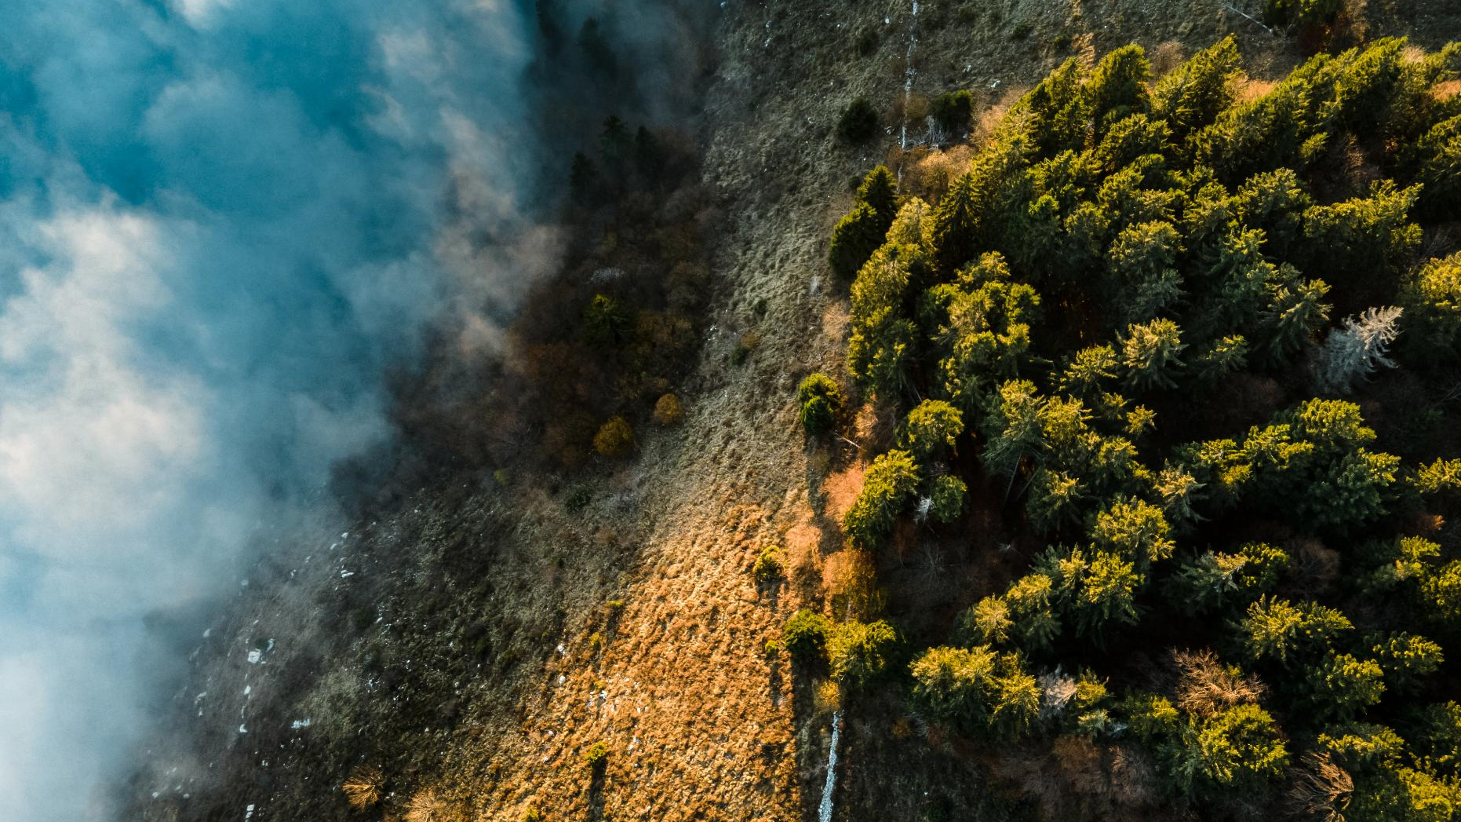
Tohil: AI-Powered Wildfire Management
Harnessing technology to combat wildfires effectively
Notes:
AI-generated content may be incorrect. --- Tohil is an innovative project leveraging artificial intelligence to tackle the growing threat of wildfires. This presentation will explore our mission, the challenges of wildfires, and the technological solutions we provide to empower communities and save lives.

Slide 2
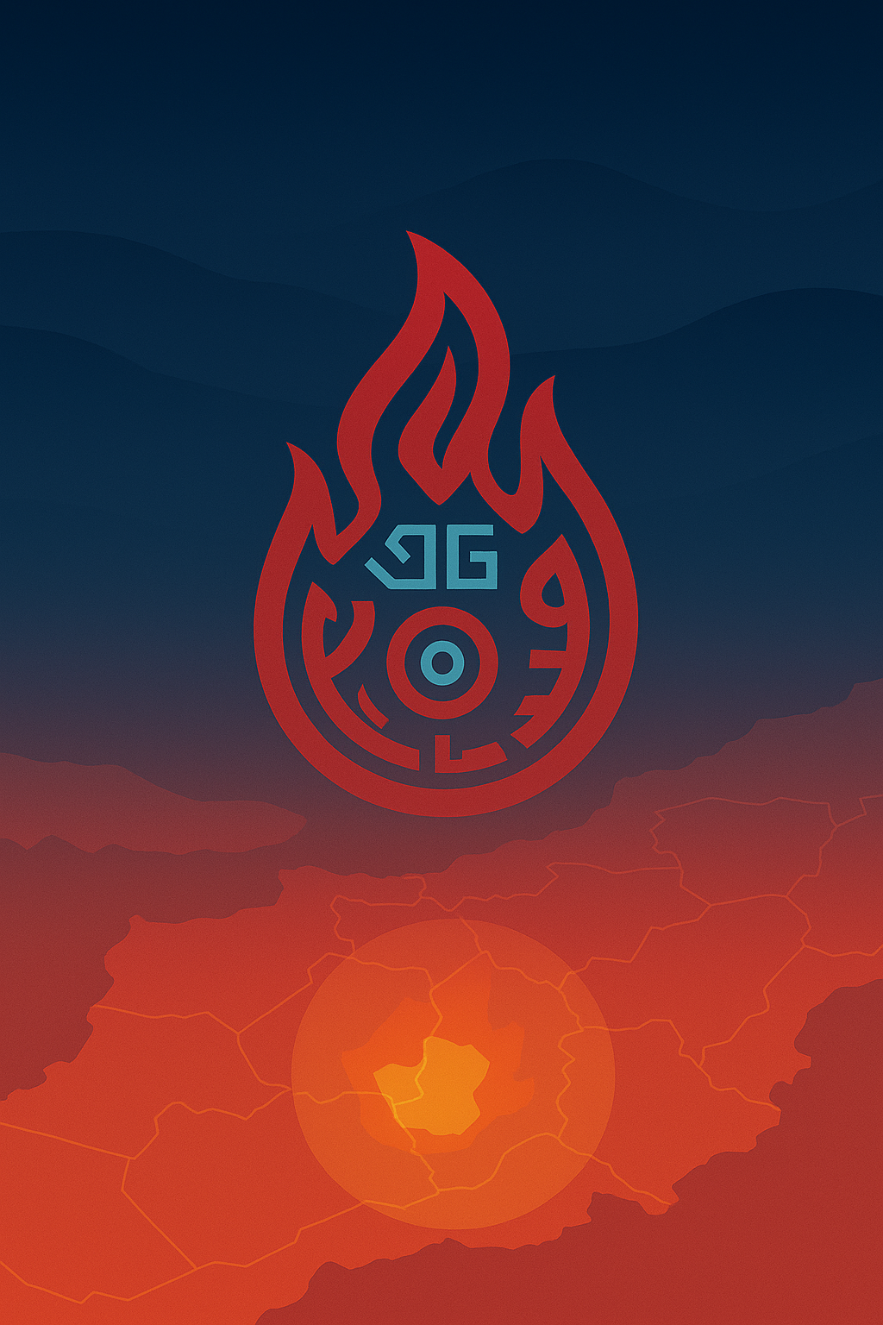

Agenda Items
Overview
The Problem of Wildfires
Our Solution
Technology Stack
Key Capabilities
Impact on Communities
Responsible AI Commitment
Notes:
We will begin with an introduction to Tohil, including its symbolism and mission. Then, we will discuss the pressing problem of wildfires and the need for efficient management. Following that, we will outline our AI-driven solutions, technology stack, key capabilities, and the positive impact on communities. Finally, we will highlight the Azure advantages and our commitment to responsible AI.

Slide 3

Overview of Tohil
Mayan God of Fire
Tohil - Wildfire intelligence system Named after the Mayan god of fire symbolizes both the life-giving warmth that sustained ancient civilizations and the destructive force that demands respect. Our platform embraces this duality, creating a digital ecosystem that alerts authorities and guides citizens during wildfire threats, helping communities act swiftly and stay safe.
Creators:
Nancy Vázquez Morales
Ricardo Zamudio Carbajal
Notes:
Tohil is named after the Mayan God of Fire, symbolizing transformation and renewal. Our project embodies the spirit of resilience and innovation in combating wildfires.

Slide 4
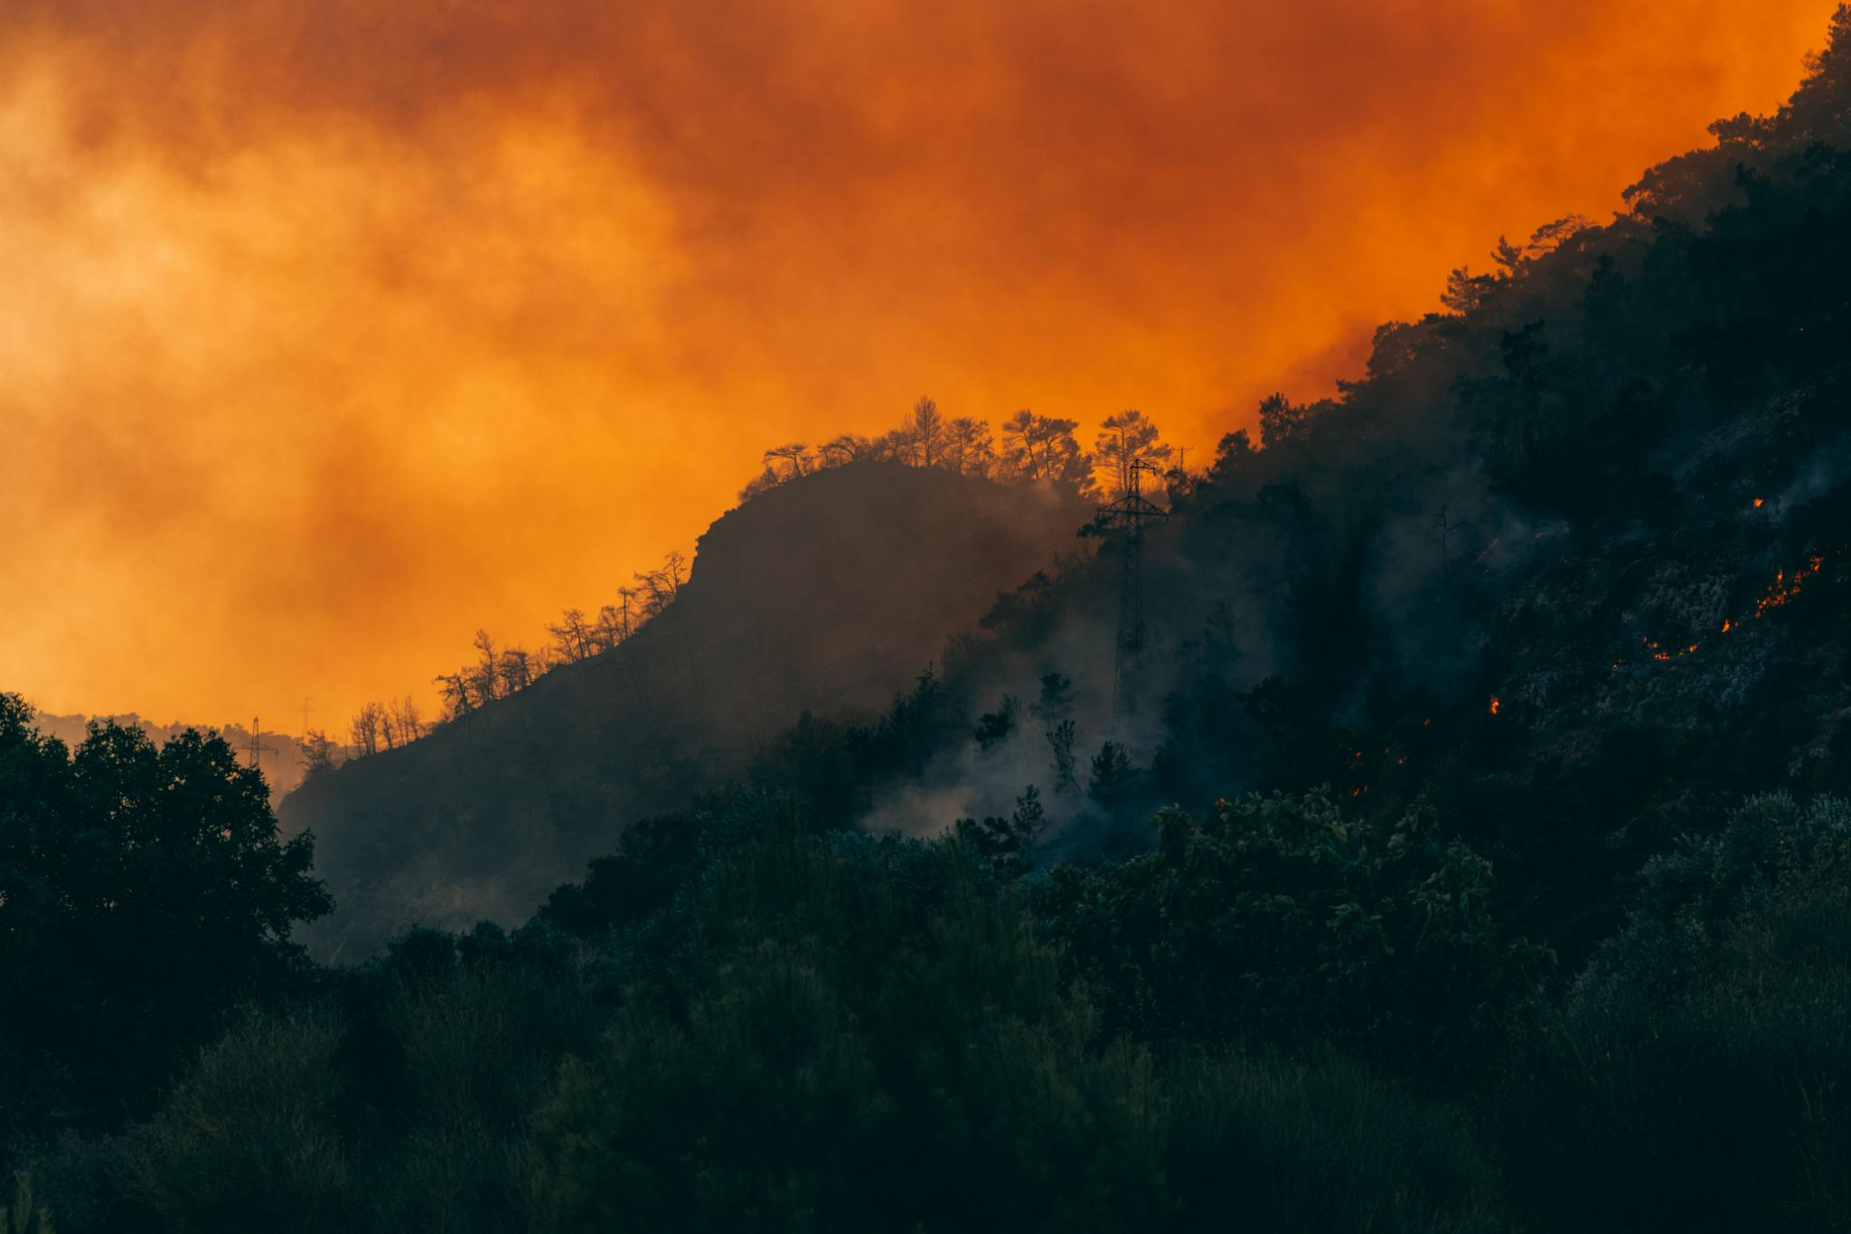
Global Increase in Wildfires
Surge in Wildfire Incidents
The frequency of wildfires has dramatically increased in recent years, impacting ecosystems and communities across the globe.
Wildfires have escalated significantly worldwide, fueled by climate change and urban expansion. Each year, the US faces catastrophic losses with over 10 million acres burned, causing substantial economic damage exceeding $20 billion annually in California alone. Communities urgently need smarter, quicker, and more accurate tools to manage these escalating threats
Notes:
In recent years, the frequency and intensity of wildfires have surged worldwide due to climate change and human activities. This trend poses significant risks to life and property.

Slide 5
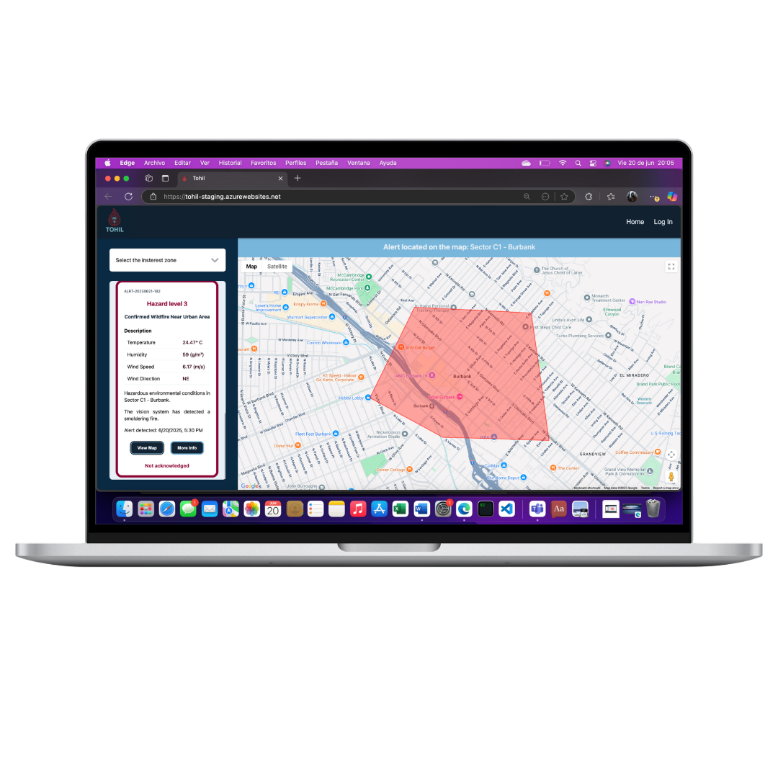
Predicting Wildfire Spread
Advanced analysis
We utilize stream analysis that analyze vast amounts of environmental data to predict wildfire behavior accurately.
Proactive Risk Mitigation
By predicting wildfire behavior, we can take proactive measures to mitigate risks before they escalate into larger disasters.
Notes:
Our advanced algorithms analyze environmental data to predict wildfire behavior, enabling proactive measures to mitigate risks before they escalate.

Slide 6
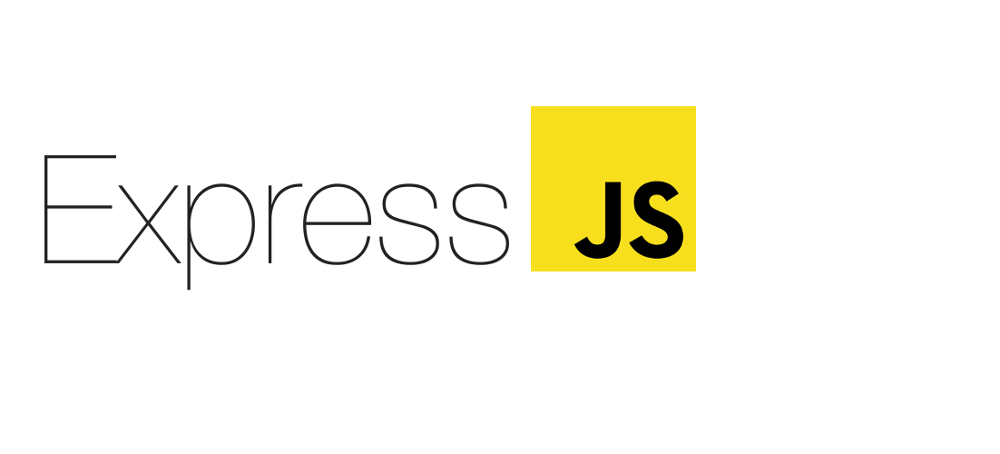
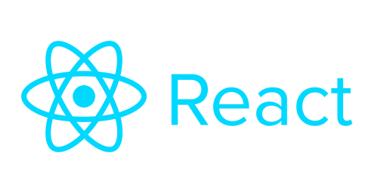

Backend Technologies
Tohil's backend infrastructure is robust and efficient, powered by Node.js and Express.js for real-time, high-performance data processing. We harness Azure AI Foundry’s powerful Large Language Models to generate accurate, actionable recommendations. The entire system is reliably hosted on Azure App Services, ensuring scalability, security, and global accessibility.
Our frontend leverages React.js for creating intuitive and interactive user interfaces, along with HTML, CSS, and JavaScript for dynamic real-time data visualization.
Notes:
We utilize robust backend technologies to support data processing, predictive modeling, and analysis, ensuring scalability and reliability in our operations.

Slide 7
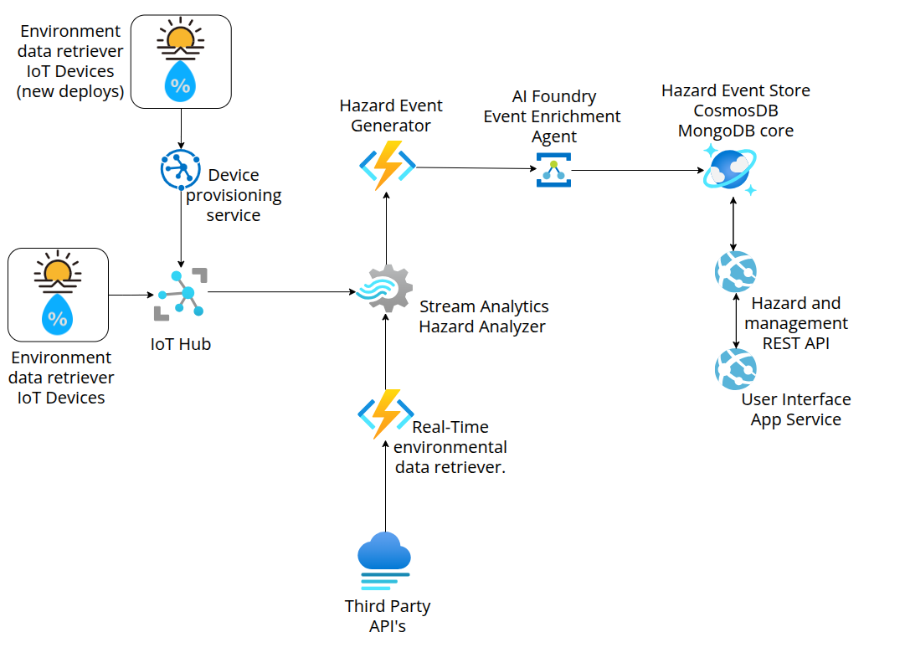

Integration of Azure Services
Notes:
Tohil leverages Azure services for cloud computing, data storage, and AI analytics, enabling us to harness the power of scalable infrastructure and advanced technologies.

Slide 8
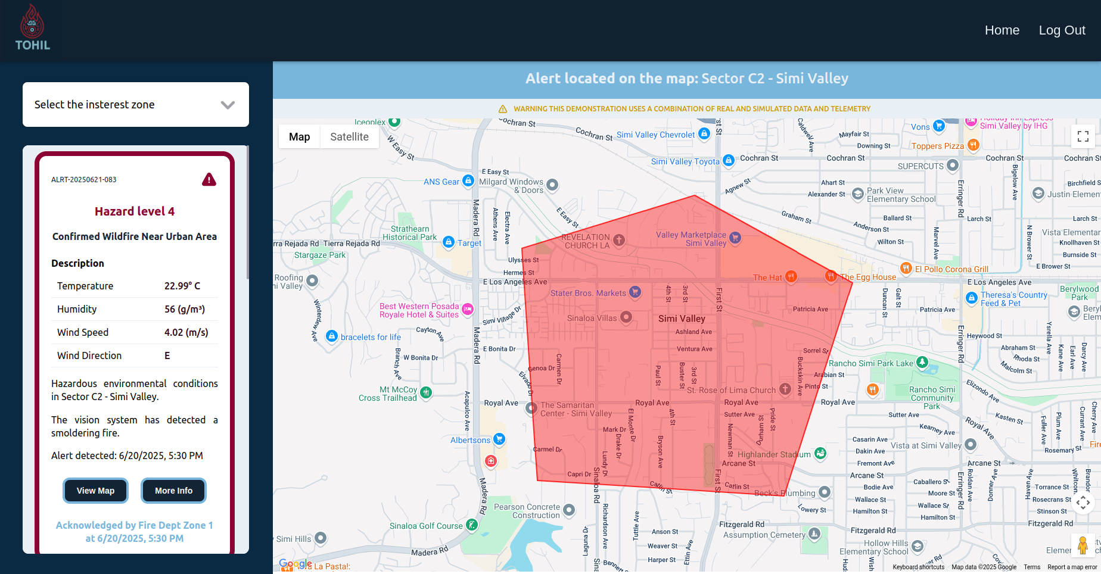
Interactive Hazard Maps
Visualization of Wildfire Risks
Interactive hazard maps provide a visual representation of areas at risk for wildfires, helping users assess danger levels.
Informed Decision-Making
These maps enable users to make informed decisions regarding safety and evacuation plans during wildfire events.
Notes:
Our interactive hazard maps visualize wildfire risks, allowing users to understand the situation and make informed decisions about safety and evacuation.

Slide 9
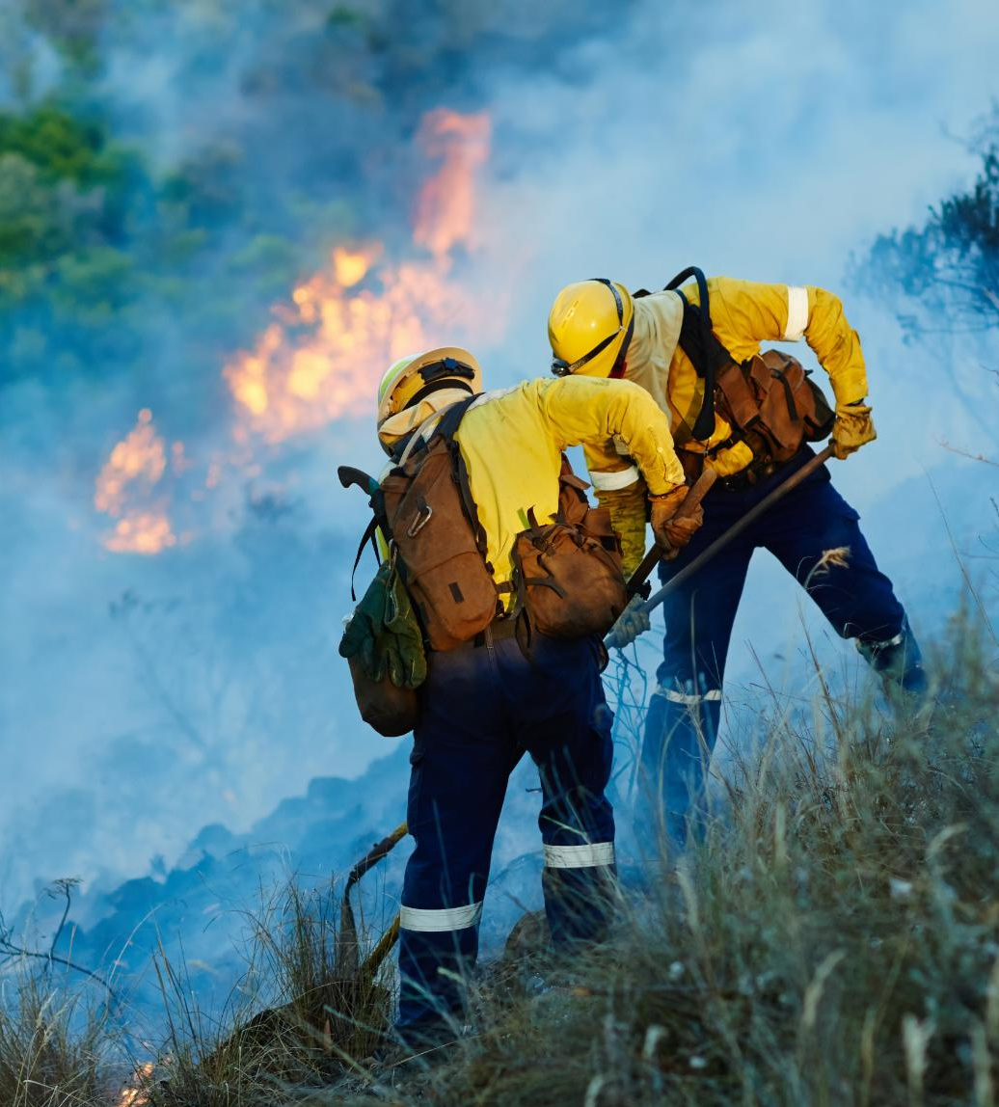
Economic Savings
Life-Saving Measures
Effective wildfire management strategies save lives by preventing devastating wildfires and ensuring community safety.
Cost Reduction
Investing in wildfire management reduces economic costs associated with damages and recovery efforts after wildfires occur.
Long-Term Benefits
By managing wildfires effectively, communities can ensure long-term economic stability and reduce future wildfire impacts.
Notes:
Effective wildfire management not only saves lives but also results in significant economic savings, reducing the costs associated with wildfire damages and recovery.

Slide 10

Commitment to Responsible AI
We firmly adhere to Microsoft’s Responsible AI principles, ensuring ethical AI deployment. Our platform emphasizes fairness, actively identifying and mitigating biases to deliver equitable insights. We provide transparency, clearly explaining decisions and insights to maintain user trust.
Privacy and security are paramount, adhering strictly to global standards such as GDPR and ensuring all data is securely managed.
Notes:
We strive to ensure that our AI models are fair and unbiased, actively working to identify and mitigate any potential biases in our processes.

Slide 11
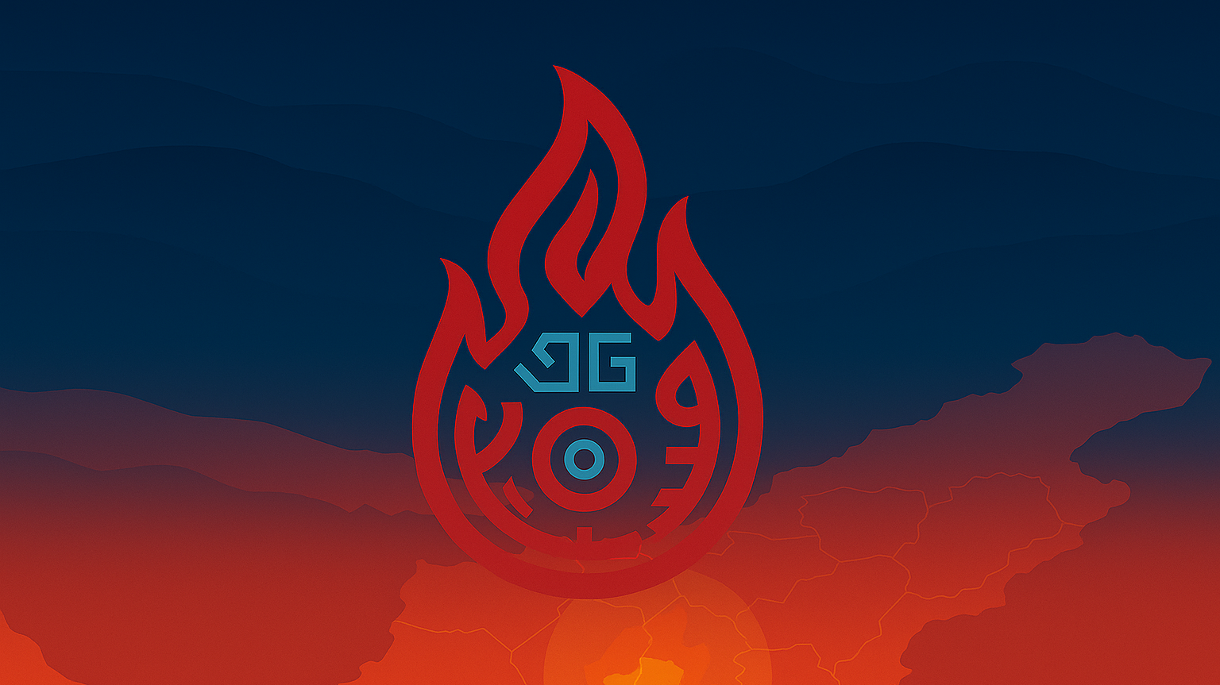
THANK YOU

